Slide 1
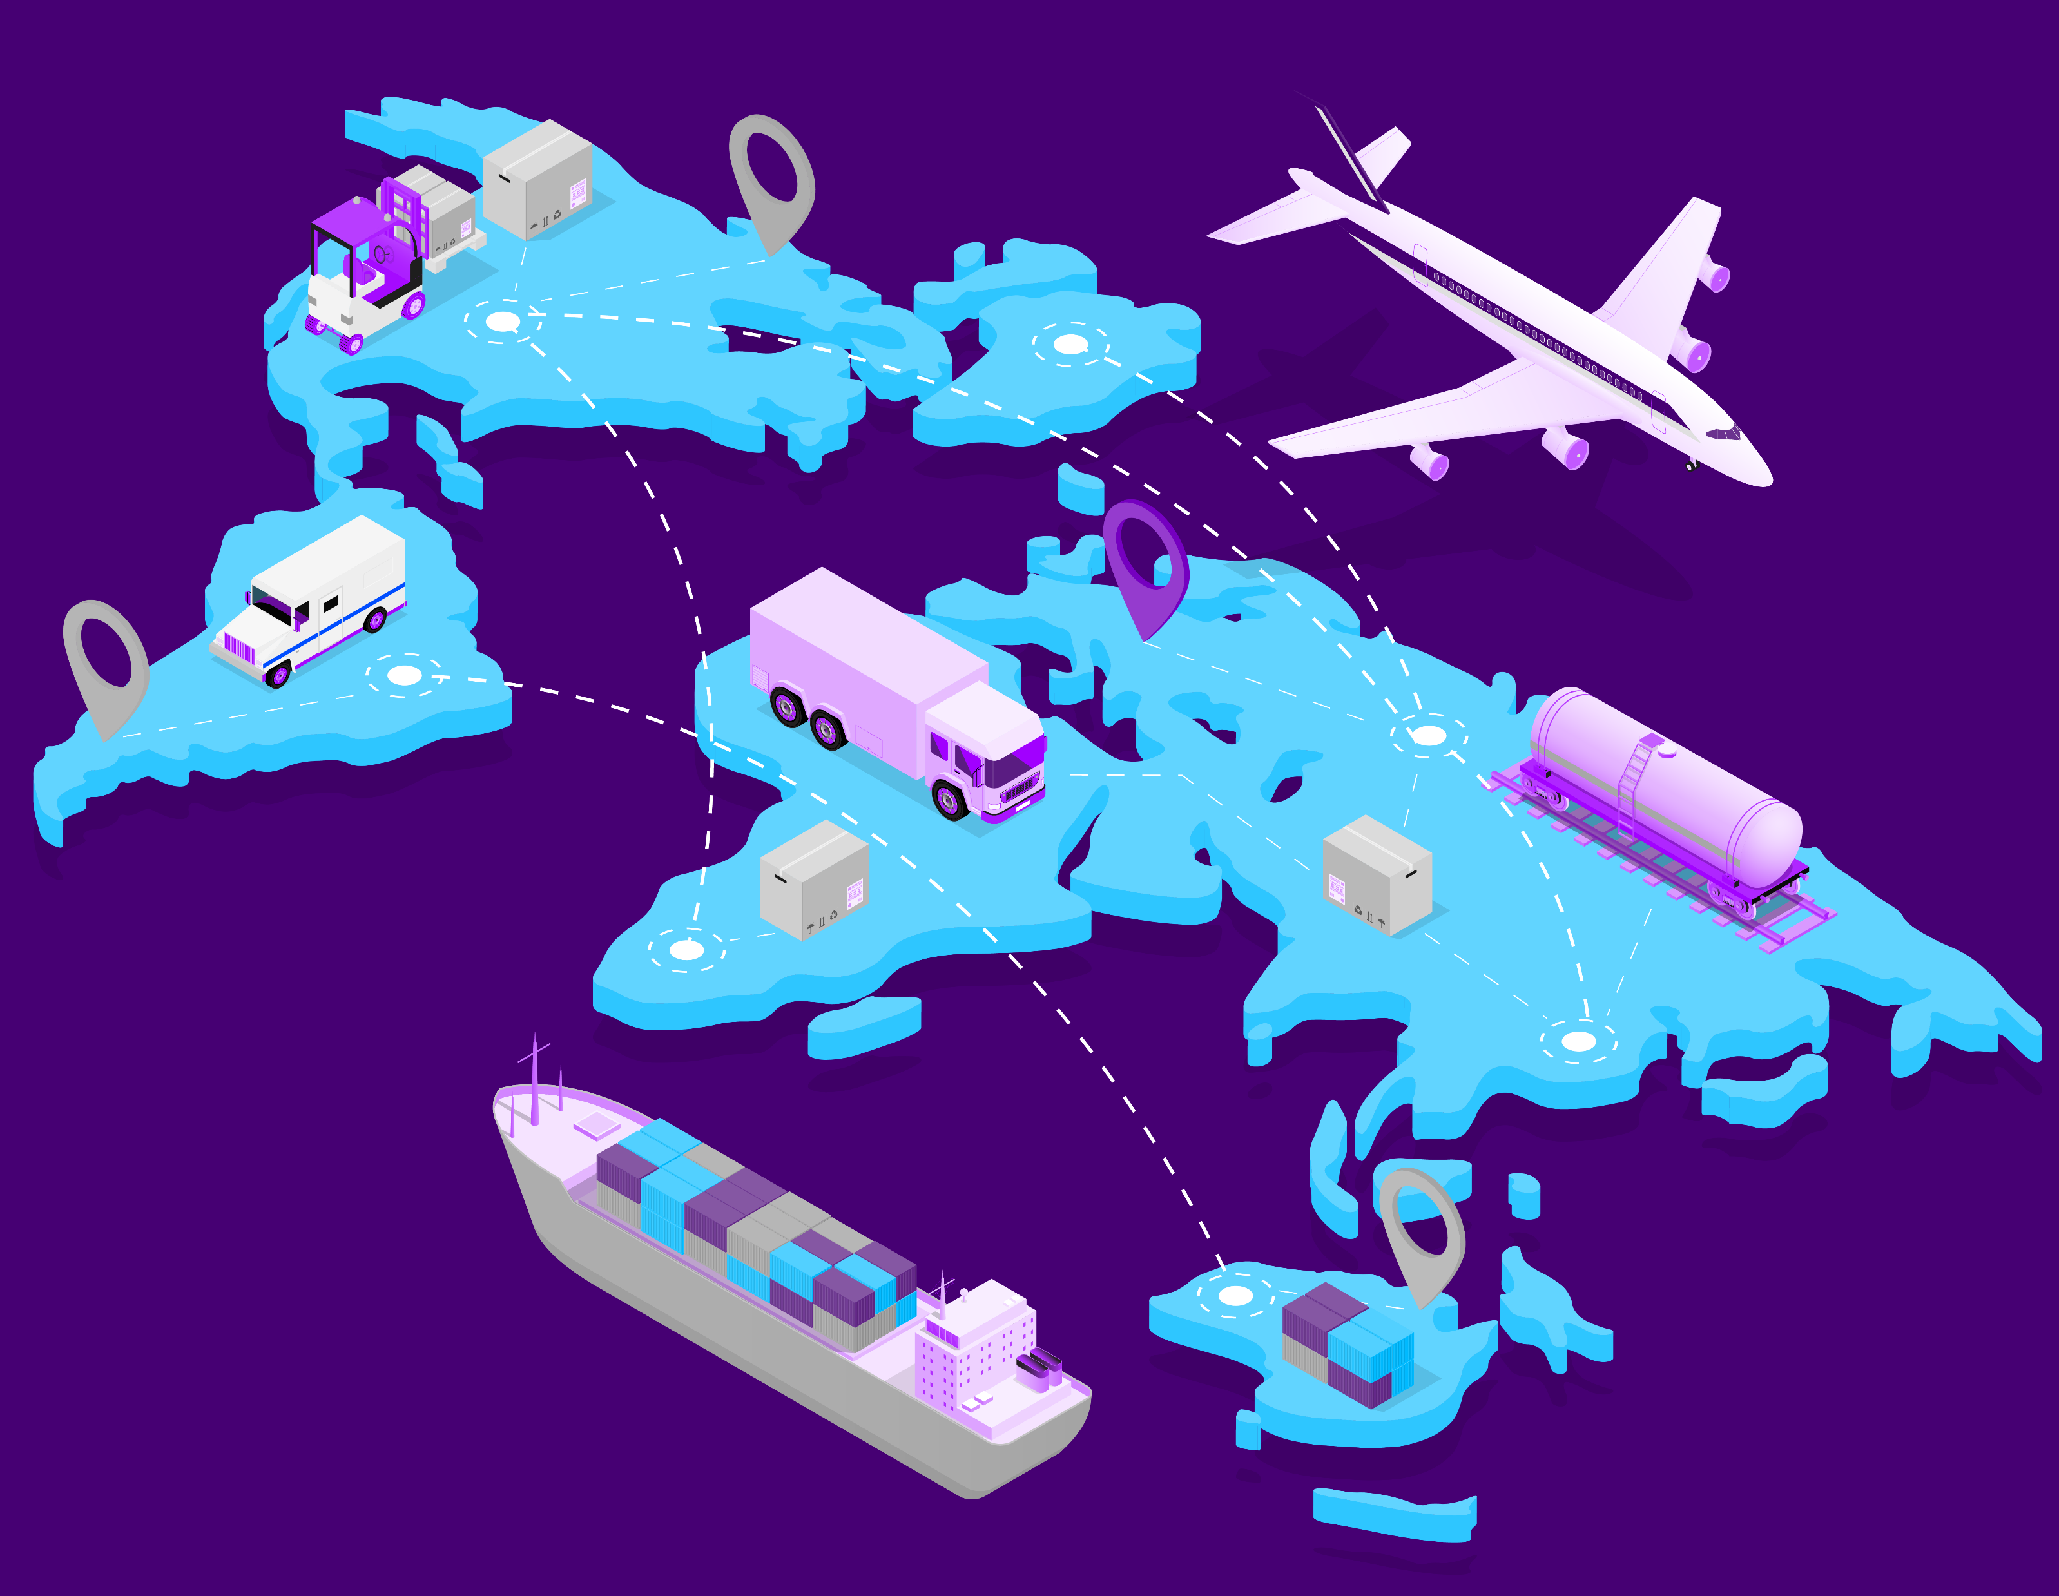

Presentation of the graduation project for
Belarusian State University of Informatics and Radioelectronics
Created by Piotr Myszkowski

Slide 2
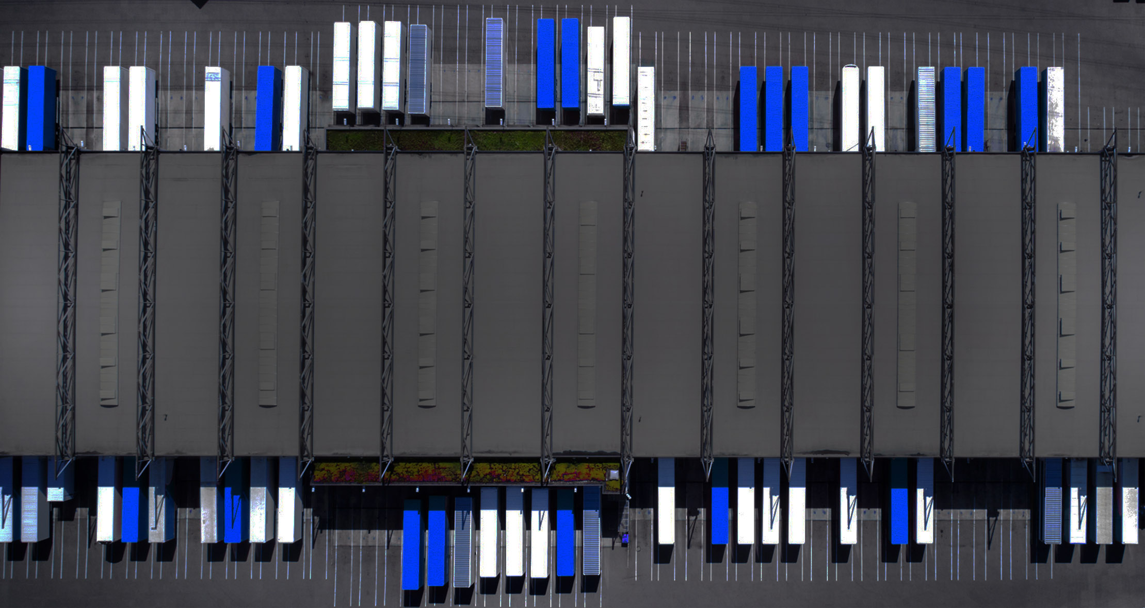
BSUIR
Introduction

Slide 3
Start a Trucking Business
01
Have a business plan
02
What kind of company?
03
Start-up expenses
04
Business operations
05
Get a truck and/or trailer
06
Insurance

Slide 4
Identifying the problems of
Small to medium Logistics companies
Paper based business model
There is still significant amount of freight transportation companies that are using pen and paper to run their business
Security / disaster free
Almost every company is facing security issue. In logistics industry this is one of the most concern. Every company wants to secure their customer and their own data from their competition or from potential fraud. Also they have to face disaster problems to protect their data.
Managing inventory
When business is going good company tends to be more and more on demand. With that these logistics companies have to grow by buying more equipment that helps move load from point A to point B.
Getting online
If companies want to grow and accrue more business they have to be available online for their customers and employees.

Slide 5
How do we resolve Logistics companies problems
Web/mobile online
All data are stored in the cloud on RDBMS storage. With this software companies wont need paper and pen to run their business other then taking a notes
Cloud secure
Companies wont have to worry about their data. All the data is secured and backed up by cloud provider. The data center are secured and only authorized personnel have physical and digital access. Data is replicated on three different and independent machines.
Managing inventory
With easy to use user interface managing inventory like trucks, trailers or different assets like customer, drivers, loads are intuitive and fast.
24/7/345 – online availability
Thanks to the cloud technologies the availability and down town are not he issue. Also, with secure API layer it is easy to integrate with different variety of system.

Slide 6


What is the
Market for crm systems
Worldwide CRM software revenue amounted to $39.5 billion in 2018 overtaking DBMS revenue, which reached $36.8 billion in the same year.
"In 2019, CRM software revenue will continue to take the lead of all software markets and be the fastest growing software market with a growth rate of 16 percent." - said Julian Poulter, research director at Gartner.

Slide 7
BSUIR
How does it work

Slide 8
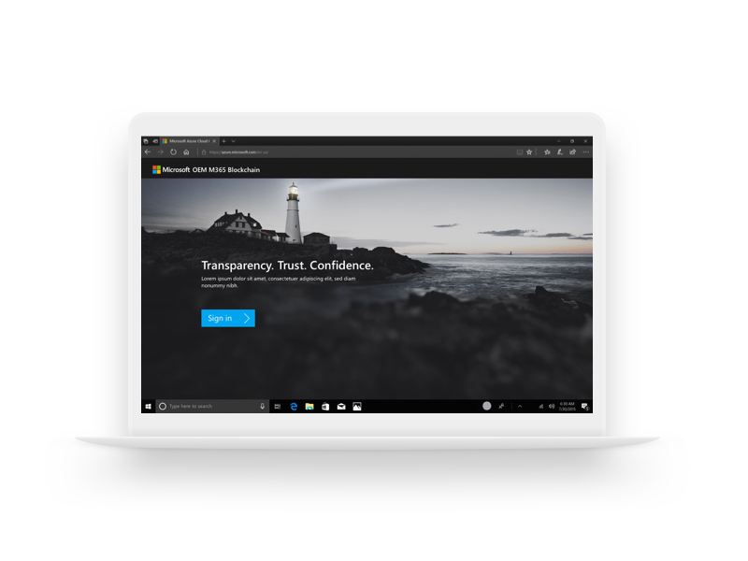
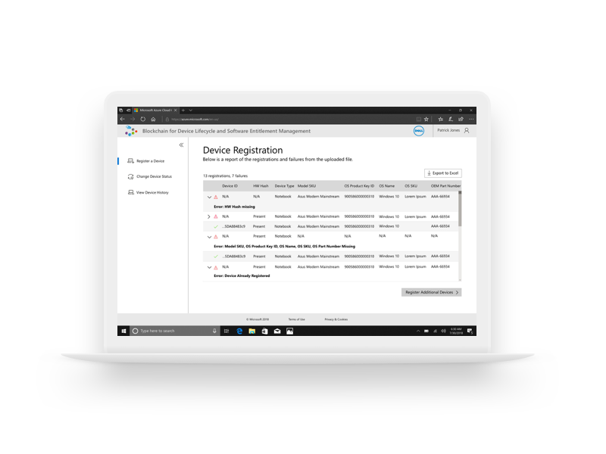
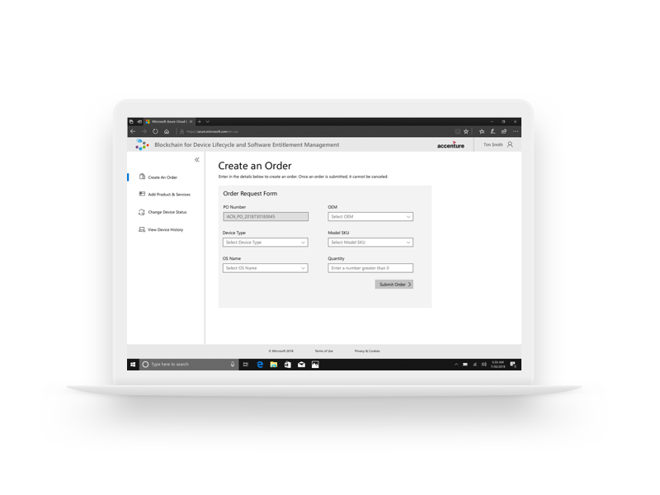

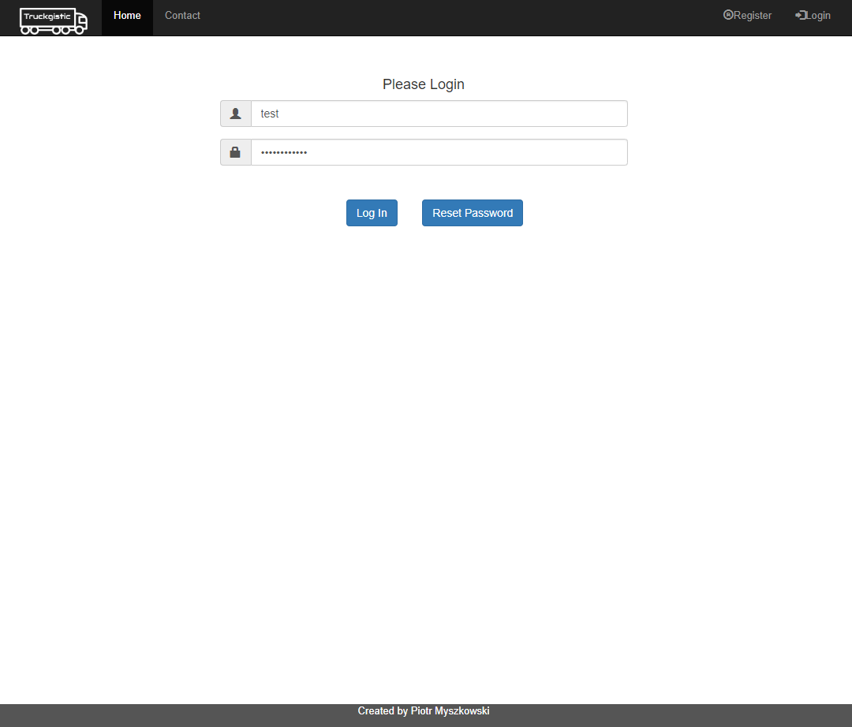
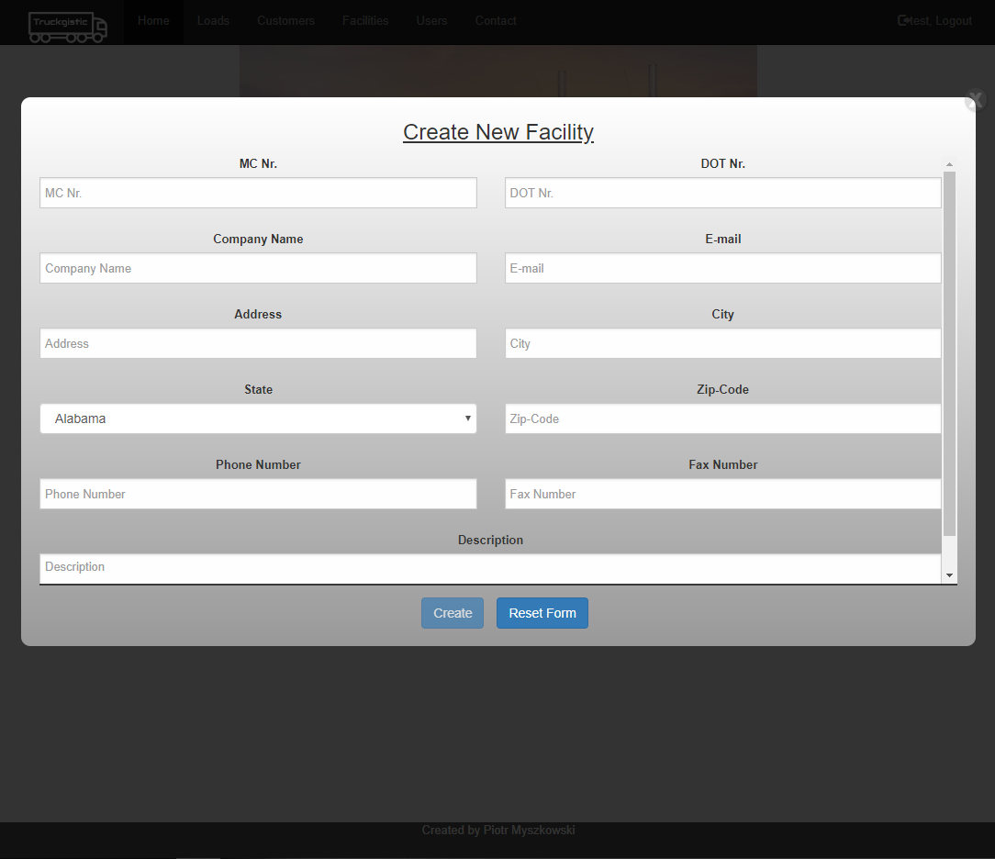
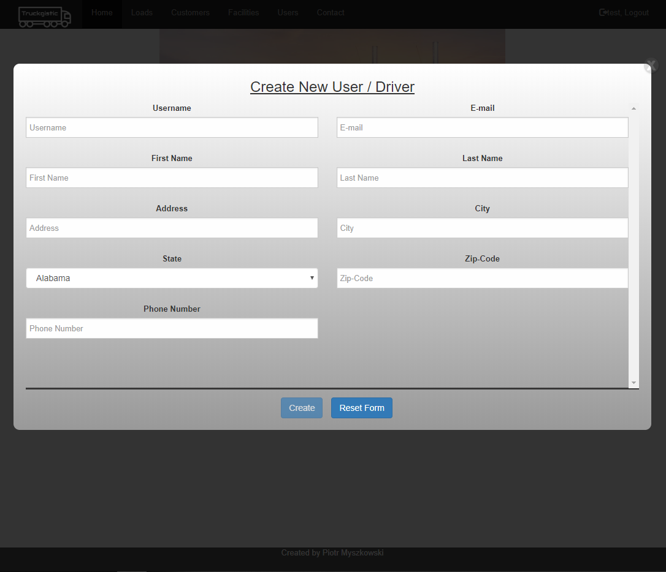
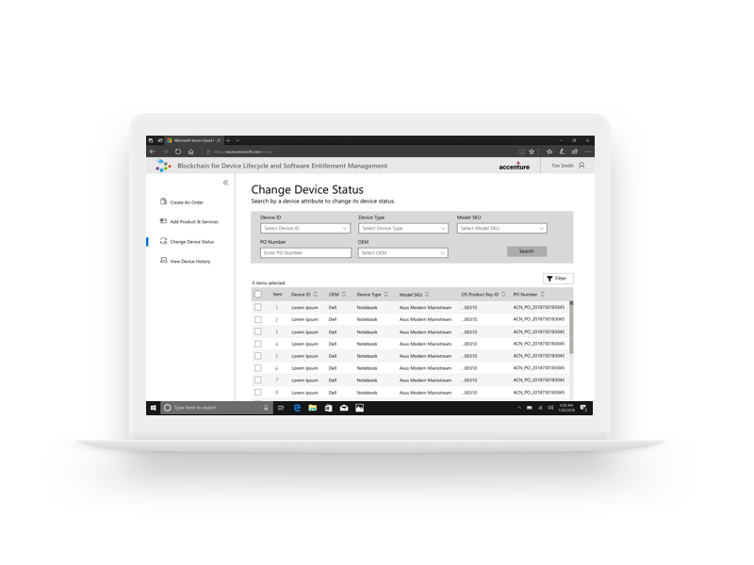
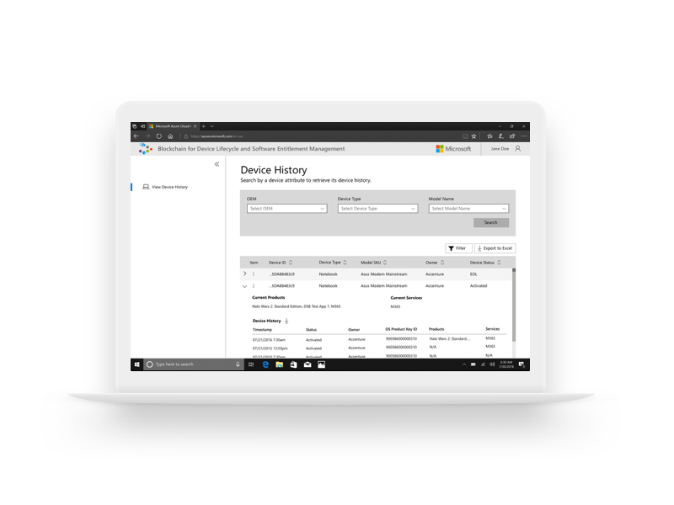
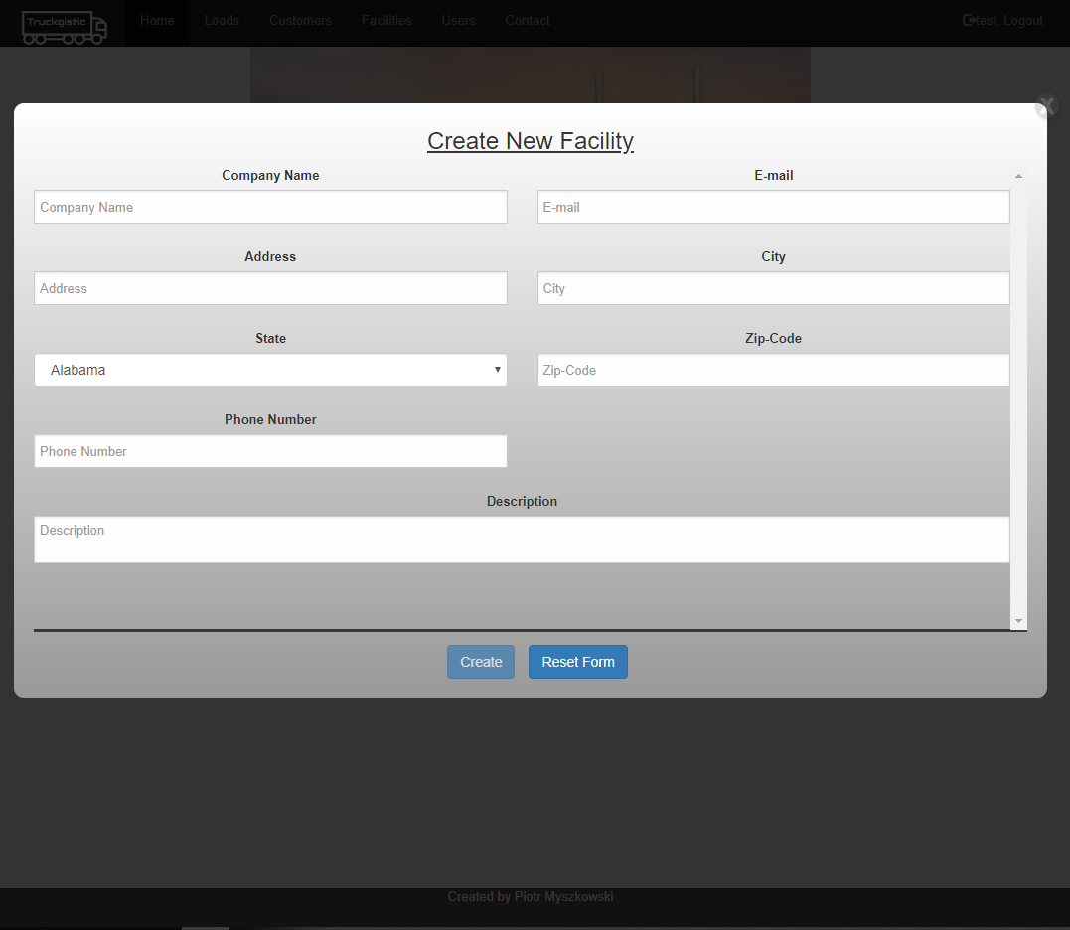
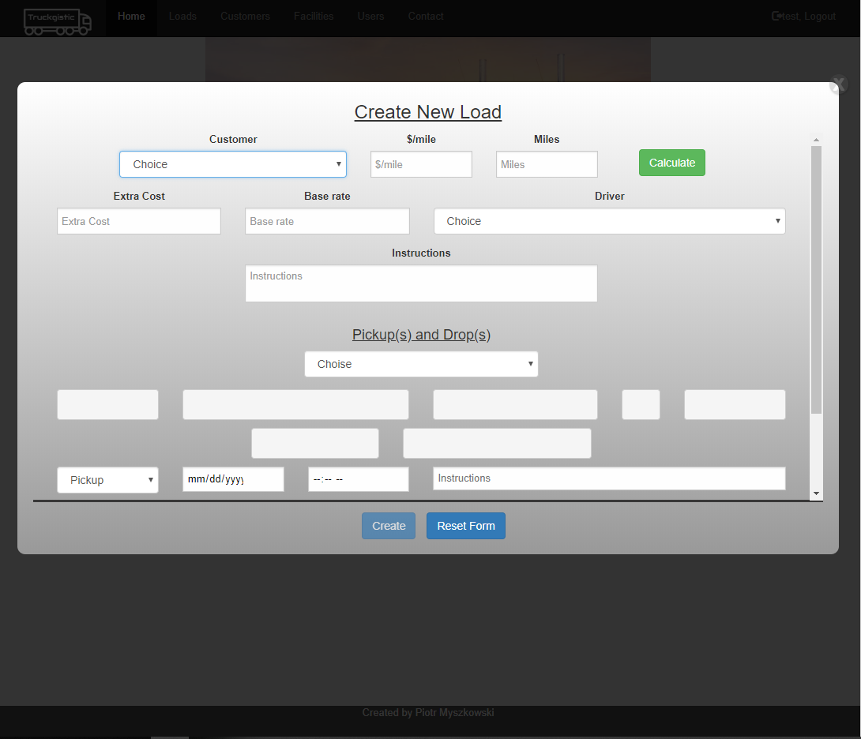
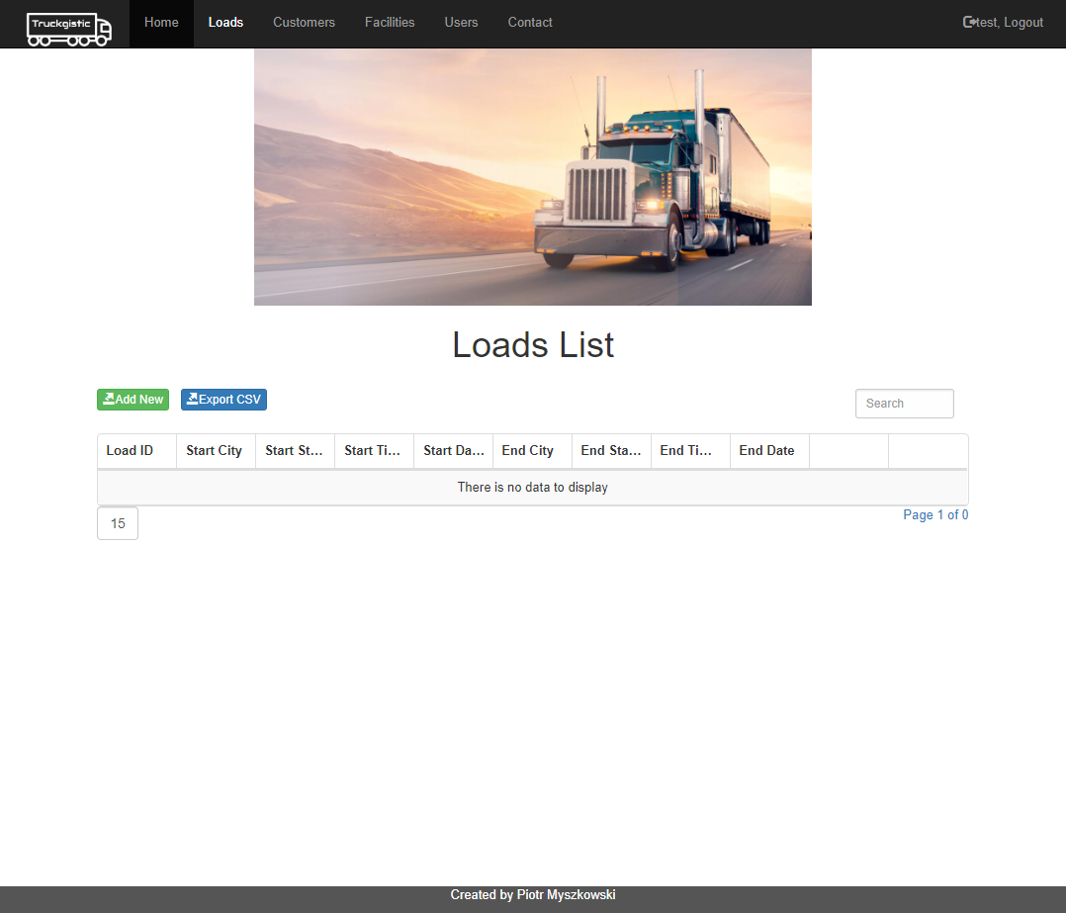
Dispatch logs In
User Interface
Dispatch create customer
Dispatch crates Driver
1
2
3
Dispatch creates pickup and delivery facility
Dispatch creates load
Dispatch can see the status of the load
4
5
6

Slide 9
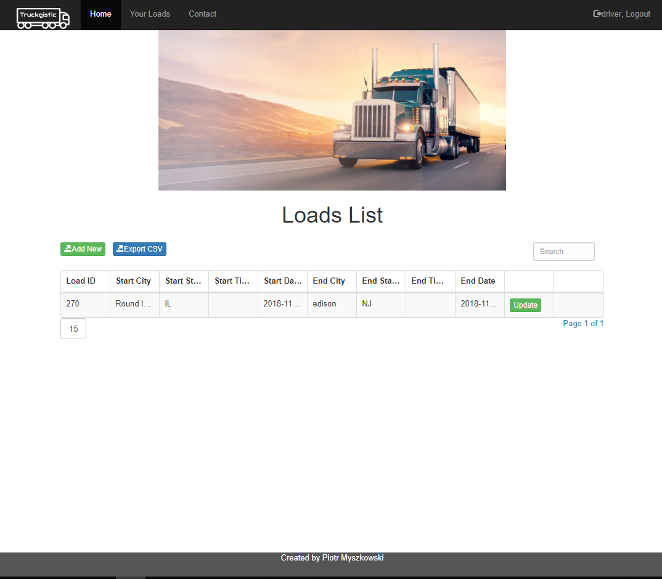
driver logs In
User Interface
driver give update about the load
Driver checks for assign loads
1
2
3

Slide 10
BSUIR
architecture design

Slide 11





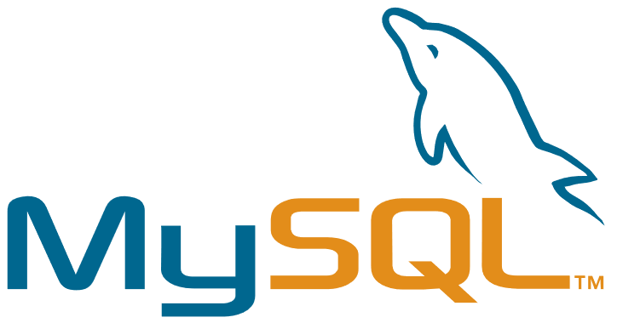
UI layer
API layer
Database

Slide 12
BSUIR
What is next?

Slide 13

Blockchain as a decentralized ledger
Secured, verified, imputable database
Blockchain is an open, secure data structure of sequential blocks which are added, defined by, and shared among multiple parties in a multi-node network.
Cryptography and digital signatures ensures authenticity, proof-of-identity and enforces read/write access rights while allowing contributors to be anonymous
Blocks are verified and added in near real-time eliminating arbitrage risks or data-sync problems

Slide 14
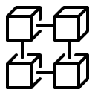





Combining blockchain with other technologies
To reach the quartile 0 supply chain
Connecting together
Combining IoT, AI and Blockchain together is one of the most popular use case when presenting these technologies
With IoT device installed in the trailer or truck we can track real time the temperature, humidity, location of the freight that is being transported
If we leverage AI with IoT device we can predict maintenance on the truck or trailer, monitor driver behavior and notify the main office about illegal
Different parties like Manufacture, Supplier, Customer with guarantee that everything is secure

